Slide 1
Data Models, Data Instances and Schema
Lecture 3

Slide 2
Data Models
A data model is a conceptual representation of the data structures that are required by a database.
To use a common analogy, the data model is equivalent to an architect's building plans.
Data model organizes data for various users.
Facilitate interaction among the designer, the applications programmer and the end user
‹#›

Slide 3
Type of Data Models
Hierarchical Model
Network Model
Relational Model
Entity-relationship Model
Object Based Model
‹#›

Slide 4
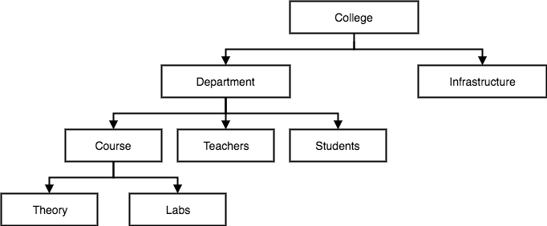
Hierarchical Model
In hierarchical model, data is organized into tree-like structure with one-to-many relationship between two different types of data, for example, one department can have many courses, many professors and of-course many students.
‹#›

Slide 5
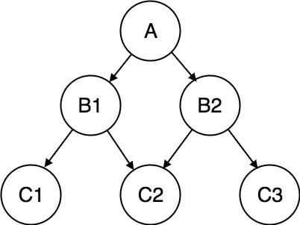
Network Model
This is an extension of the Hierarchical model. In this model data is organized more like a graph, and are allowed to have more than one parent node.
Allow more connection between nodes Ex: A employee work for two department is not possible in hierarchical model, but here it is possible
‹#›

Slide 6
Relational Model
This type of model designs the data in the form of rows and columns within a table.
A relational model uses tables for representing data and in-between relationships. Tables are also called relations.
This model was initially described by Edgar F. Codd, in 1969.
The relational data model is the widely used model which is primarily used by commercial data processing applications.
‹#›

Slide 7
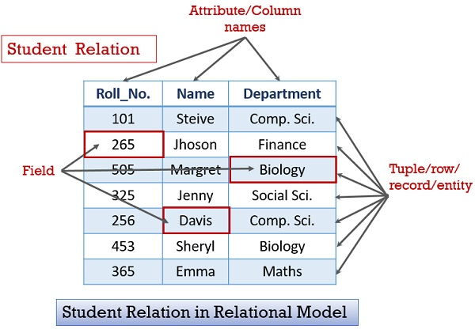
‹#›

Slide 8
Entity-relationship Model
An ER model is the logical representation of data as objects and relationships among them. These objects are known as entities, and relationship is an association among these entities.
This model was designed by Peter Chen and published in 1976 papers.
It was widely used in database designing.
A set of attributes describe the entities. For example, student_name, student_id describes the 'student' entity.
‹#›

Slide 9
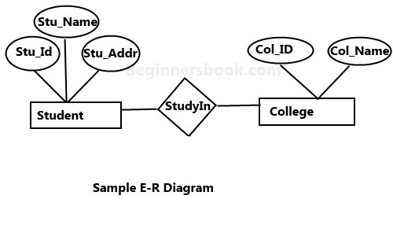
E-R Model
‹#›

Slide 10
Object based data model
An extension of the ER model with notions of functions, encapsulation, and object identity, as well.
This model supports a rich type system that includes structured and collection types.
Here, the objects are nothing but the data carrying its properties.
‹#›

Slide 11
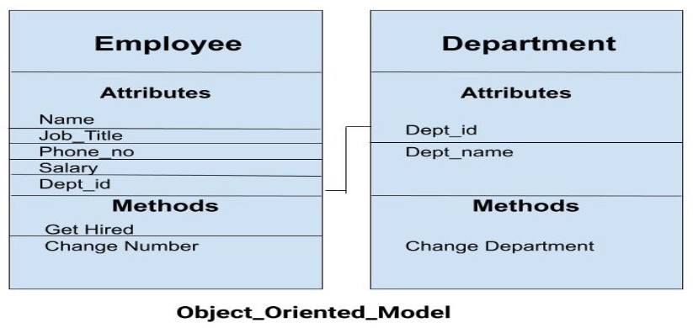
‹#›

Slide 12
Database Schema
A database schema is the skeleton structure that represents the logical view of the entire database. It defines how the data is organized and how the relations among them are associated. It formulates all the constraints that are to be applied on the data.
‹#›

Slide 13
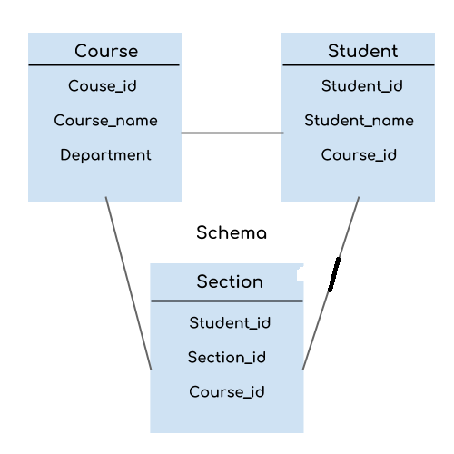
For example: In the following diagram, we have a schema that shows the relationship between three tables: Course, Student and Section. The diagram only shows the design of the database, it doesn’t show the data present in those tables. Schema is only a structural view(design) of a database as shown in the diagram below.
‹#›

Slide 14
Types of schema: Schema is of three types: Physical schema, logical schema and view schema.
The design of a database at physical level is called physical schema, how the data stored in blocks of storage is described at this level.
Design of database at logical level is called logical schema, programmers and database administrators work at this level, at this level data can be described as certain types of data records gets stored in data structure.
Design of database at view level is called view schema. This generally describes end user interaction with database systems.
‹#›

Slide 15
Database Instance
A database instance is a state of operational database with data at any given time. It contains a snapshot of the database. Database instances tend to change with time.
For example, lets say we have a single table student in the database, today the table has 100 records, so today the instance of the database has 100 records. Lets say we are going to add another 100 records in this table by tomorrow so the instance of database tomorrow will have 200 records in table.
‹#›

Slide 16
Data Abstraction in DBMS
Data abstraction is a process of hiding the implement details (such as how the data are stored and maintained) and representing only the essential features to simplify user's interaction with the system.
The major purpose of a database system is to provide users with an abstract view of the system
‹#›

Slide 17
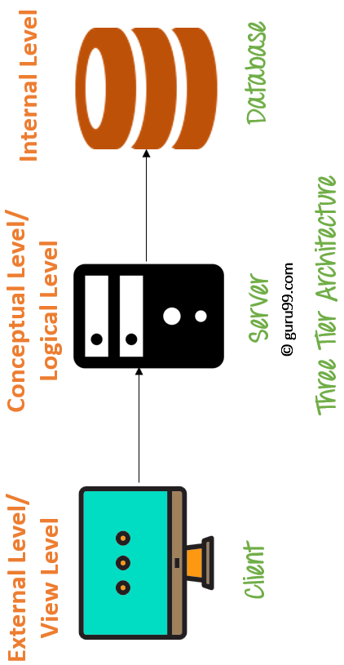
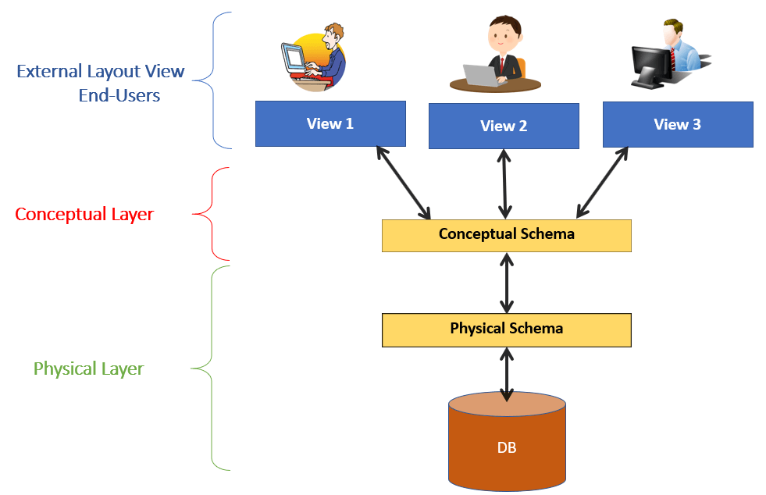
DBMS – Three Level Architecture
View Schema/
Sub Schema
The objective of Three level architecture model is to achieve
data abstraction.
‹#›

Slide 18
Three schema Architecture
The three schema architecture is also called ANSI/SPARC architecture or three-level architecture.
This framework is used to describe the structure of a specific database system.
The three schema architecture is also used to separate the user applications and physical database.
The three schema architecture contains three-levels. It breaks the database down into three different categories.
‹#›

Slide 19
Physical level: This is the lowest level of data abstraction. It describes how data is actually stored in database. You can get the complex data structure details at this level.
Logical level: This is the middle level of 3-level data abstraction architecture. It describes what data is stored in database.
View level: Highest level of data abstraction. This level describes the user interaction with database system.
‹#›

Slide 20
Example: Let’s say we are storing customer information in a customer table. At physical level these records can be described as blocks of storage (bytes, gigabytes, terabytes etc.) in memory. These details are often hidden from the programmers.
At the logical level these records can be described as fields and attributes along with their data types, their relationship among each other can be logically implemented. The programmers generally work at this level because they are aware of such things about database systems.
At view level, user just interact with system with the help of GUI and enter the details at the screen, they are not aware of how the data is stored and what data is stored; such details are hidden from them.
‹#›

